Slide 1
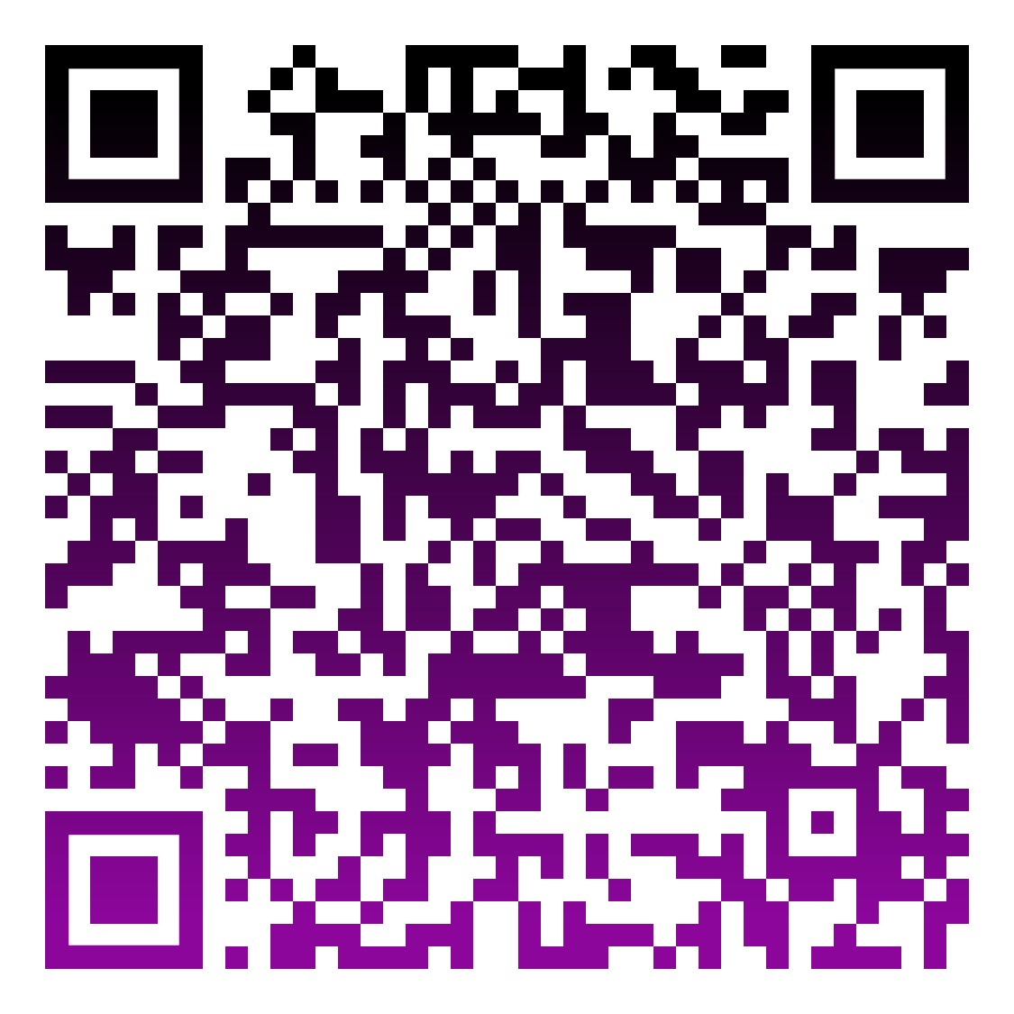
BYOBox
Sleep Out Event
Drop boxes for donations will be available at
campsites
NATIONAL HOMELESSNESS AND HUNGER AWARENESS WEEK
JOIN US FOR
WELLSPRING’S SLEEP OUT EVENT
November 17 @ 6pm to
November 18 @ 6am
Our Mission:
To serve those experiencing the effects of poverty by offering opportunities to stabilize their lives through housing, advocacy, support, and paths to self-sufficiency.
Grab a Box!
Grab some Friends!
Set Up Your Donation Site!
For more information on campsites or setting up a fundraising page
contact Bob Goodrum at
765-342-6661 ext. 304 Bob@wellspring.work
Drop boxes will be at WellSpring and Associated Bail Bonds for donations to support the Gunner James Burnam Food Pantry!
wellspringcenter.networkforgood.com/projects/206568-evict-poverty-and-homelessness-2023
Use the link or QR code above to sign up and start raising funds!

